Slide 1


Louisiana Resilience Task Force March 4, 2024, 11:00 AM
Stephen Swiber, Chief Resilience Officer

Slide 2
Welcome and Call to Order
Roll Call
Public Comment
Approval of Agenda
Introduction of Task Force Members- Task Force Members
History of Resilience Work to Date- Stephen Swiber, Office of the Governor
Overview of Act 315– Stephen Swiber, Office of the Governor
Resilience Report Overview and Discussion– Stephen Swiber, Office of the Governor
Strategic Discussion, Direction for Resilience Office– Task Force Members
Grant Opportunities – Stephen Swiber, Office of the Governor & Task Force Members
Updates and Announcements– Task Force Members
Adjourn
Agenda

Slide 3
Call to Order

Slide 4
Roll Call
The Chief Resilience Officer
The Director of the Governor's Office of Homeland Security and Emergency Preparedness or designee.
The Governor's Executive Assistant for Coastal Activities or designee.
The Commissioner of the Division of Administration or designee.
The Commissioner of Insurance or designee.
The Secretary of the Department of Transportation and Development or designee.
The Executive Director of the Police Jury Association of Louisiana, Inc. or designee.
The Executive Director of the Parish Presidents of Louisiana Association or designee.
The Speaker of the House of Representatives or designee.
The President of the Senate or designee.
The Executive director of the Louisiana Municipal Association or designee.
A member from the Public Service Commission.
The Commissioner of Higher Education or designee.
The Secretary of the Department of Children and Family Services or designee.
Resilience History in LA
Defining Resilience
2024 Plans
Supporting Resilience
Resilient Priorities

Slide 5
Public Comment

Slide 6
Approval of Agenda

Slide 7
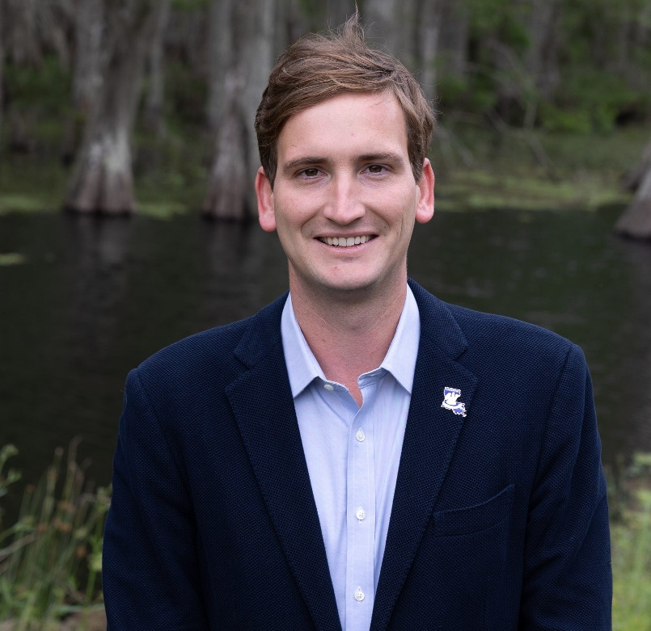
Opening Remarks
Stephen Swiber, Chief Resilience Officer
Stephen.Swiber@LA.GOV
As a lifelong Louisiana resident, I am extremely excited to help lead efforts to make Louisiana a stronger State.
Resilience building is essential to improving the everyday lives of its residents and improve our ability to respond to challenges in the future.
As the new CRO, I am here to not just talk the talk but get to work and make resilience an actionable and achievable goal for Louisiana.

Slide 8

History of Resilience in Louisiana
Governor’s Office of Coastal Activities
The Resilience Officer and GOCA directs and coordinates the development and implementation of policies, plans, and programs which encourage multiple uses of the coastal zone and achieve a proper balance between development and conservation, restoration, creation, and nourishment of coastal resources.
Public facing website resilience.la.gov goes live & resilience grants tracked on infrastructure.la.gov
December 2005: Formulation of CPRA following Hurricane Katrina
Louisiana Legislature restructured the State’s Wetland Conservation and Restoration Authority to form the Coastal Protection and Restoration Authority.
Goal: Address recovery issues confronting Louisiana following Hurricane Katrina and Rita
First Louisiana Resilience Annual Report Released
Louisiana Becomes the 11th State to name a Chief Resilience Officer per Act 315
New CRO named to support a Resilience Louisiana
Resilience work in LA primarily focused on coastal restoration
Establish the role of CRO to advance and coordinate adaptation throughout Louisiana
Dec
2005
June 2023
2024

Slide 9
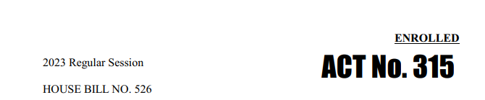
Legislative History of the Chief Resilience Officer
Legislative Background
The role of the Chief Resilience Officer was established through Act 315 of the 2023 Regular Legislative Session under House Bill 526.
.
“Resilience” shall mean a capability to
anticipate, prepare for, respond to, and
recover from significant multi-hazard threats
with minimal damage to social well-being, the
economy, infrastructure, and the
environment.
Act No. 315 of the 2023 Regular Session
Act 315 established multiple structures to build resilience in Louisiana: the Chief Resilience Officer, the Louisiana Resilience Task Force, and the Interagency Coordination Team.

Slide 10
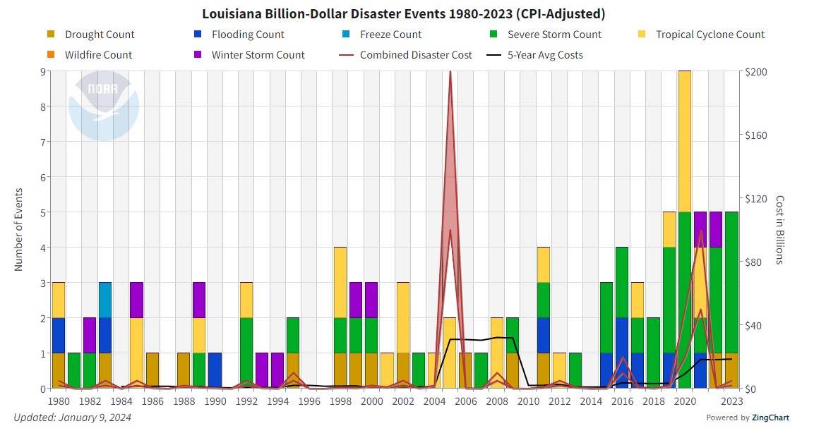
Why Resilience Beyond Just Coastal?
From 1980-2023 of the 96 separate, billion-dollar weather and climate disasters recorded by NOAA, there were 14 droughts, 10 floods, 1 freeze, 37 severe storm events, 25 tropical cyclones, and 9 winter storm events. Wildfires are a growing threat.
Louisiana Summary | Billion-Dollar Weather and Climate Disasters | National Centers for Environmental Information (NCEI) (noaa.gov)

Slide 11
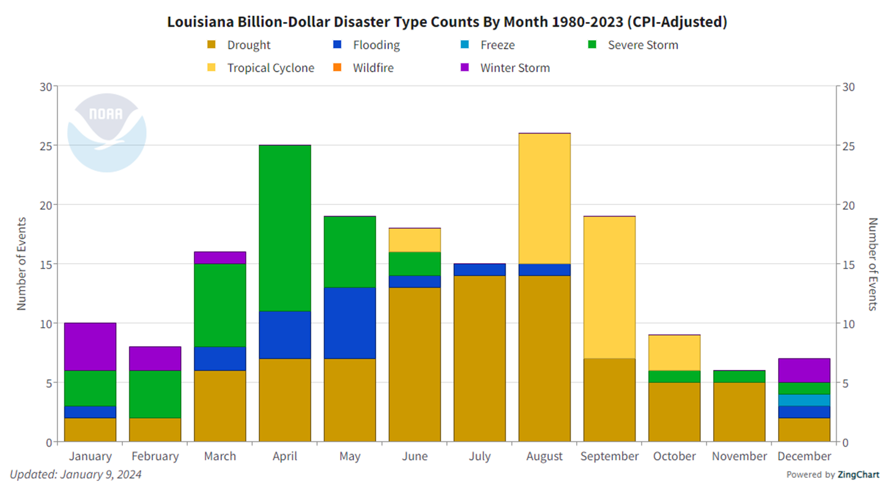
Why Resilience Beyond Just Coastal?
Disaster risk is not relegated to only coastal regions of the state, nor is it confined to tropical storm events or flooding.
Resilience efforts must expand to include more hazards, all areas of the state, and additional partners outside of state government
Louisiana Summary | Billion-Dollar Weather and Climate Disasters | National Centers for Environmental Information (NCEI) (noaa.gov)

Slide 12
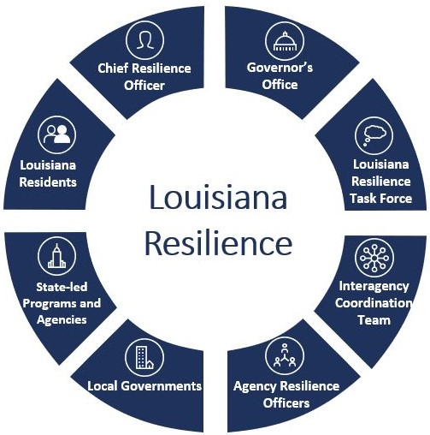
How can the Chief Resilience Officer Serve You?
As the CRO, I:
Provide coordination and strategic direction on resilience
Make recommendations to the legislature and congress with respect to Louisiana’s resilience
Pursue funding
Support planning efforts across state agencies
Provide technical guidance to agencies and local jurisdictions
Convene, report, and listen to stakeholders and the public
Produce an Annual Report available to the public
The creation of a CRO at the state level enables leaders to plan effectively across state, parish, and municipal levels, marking significant progress in safeguarding communities

Slide 13
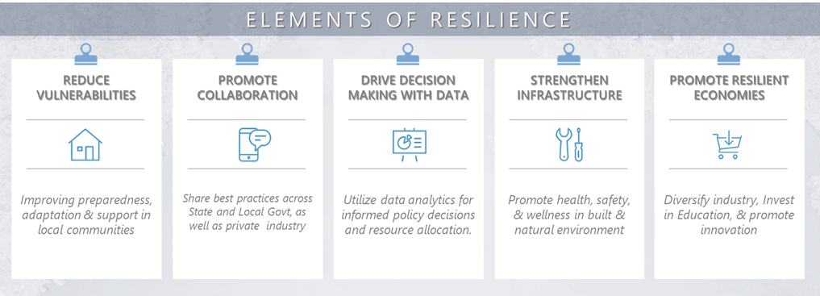
Pillars of Resilience in Louisiana

Slide 14
Legislative History of the Resilience Task Force
§220.46. Louisiana Resilience Task Force
A. There is hereby established a Louisiana Resilience Task Force to provide strategic direction to resilience efforts across the state and to make recommendations to the chief resilience officer.
B. The task force shall be composed of the following members:
(1) The chief resilience officer, who shall serve as chair and shall represent the views of the Interagency Resilience Coordination Team.
(2) The director of the Governor's Office of Homeland Security and Emergency Preparedness or his designee.
(3) The Governor's Executive Assistant for Coastal Activities or his designee.
(4) The commissioner of the division of administration or his designee.
(5) The commissioner of insurance or his designee.
(6) The secretary of the Department of Transportation and Development or his designee.
(7) The executive director of the Police Jury Association of Louisiana, Inc. or his designee.
(8) The executive director of the Parish Presidents of Louisiana Association or his designee.
(9) The speaker of the House of Representatives or his designee.
(10) The president of the Senate or his designee.
(11) The executive director of the Louisiana Municipal Association or his designee.
(12) A member from the Public Service Commission.
(13) The commissioner of higher education or his designee.
(14) The secretary of the Department of Children and Family Services or his designee.
C. The task force shall meet quarterly and at the call of the chair.
Acts 2023, No. 315, §1, eff. June 13, 2023

Slide 15
Resilience Stakeholders in Louisiana
Resilience Officers
Leaders within their agencies. They help to move agencies forward in their ability to adapt, conduct research, create programs, listen to communities, and educate peers. They are also the lead coordinators for vulnerability assessments and strategic action plans within their agency as they prioritize immediate next steps toward building resilience.
Interagency Resilience Coordination Team
Team meets regularly to promote increased communication and adaptation across government and programs.
Louisiana Resilience Task Force
Task Force provides strategic direction to the state's resilience efforts and make recommendations to the Chief Resilience Officer. The Task Force is comprised of cabinet-level officials, Legislators, the Commission of Higher Education, the Public Service Commission, and representatives from the Policy Jury Association, the Parish Presidents Association, and the Louisiana Municipal Association.
Chief Resilience Officer
Provides strategic direction for enhancing resilience in the State of Louisiana Resilience through coordination from the public-level to federal-level.
All the above stakeholders operate in public view, recognizing that the citizens of Louisiana are the most important stakeholders in enhancing resilience in our state.

Slide 16
Task Force Members

Slide 17
Please introduce your name, agency and your recommendations for building a resilient Louisiana?

Slide 18
Defining Resilience
Resilience
PREPARE
ADAPT
A key step in building a resilient Louisiana is to define what resilience means for the State and create measurable goals the CRO will report on annually.
ABSORB
RECOVER

Slide 19
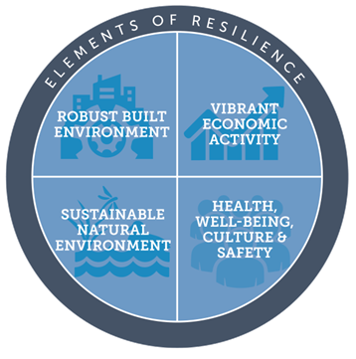
Defining Resilience
PREPARE: Create risk-informed plans, provide technical guidance and create resilience projects.
ADAPT: Ensure plans are flexible and built through an all-hazards and whole community approach
ABSORB: Resilience projects should mitigate impact of a disruptive event or crisis for Louisiana.
RECOVER: Actively support efforts, such as pursing post-disaster mitigation funding, to improve after a disruptive event or crisis to better prepare for the future.
Louisiana’s resilience spoke and hub structure allows for coordination in resilience building across the state with the Chief Resilience Officer at the helm.

Slide 20

Louisiana’s Resilient Priorities
Putting Plans into Action through Maximizing Funding
Protecting the People of Louisiana
A key aspect of resilience building for Louisiana will be an increased pursuit of funding opportunities and collaboration amongst agencies to further efforts to make Louisiana a stronger state.
Resilience projects will focus on the people of Louisiana and transparency will be a cornerstone of the office. Resilience building is essential to protect the people of Louisiana and make their everyday lives easier by making the State stronger.
Addressing Rural Community Needs including Broadband & Insurance Accessibility
Rural community needs identified across the state: 656,000 locations that lack high-speed internet, 460,000 working-age adults without adequate digital skills, and 137,000 households without digital devices, as well as a projected shortfall of 8,000 jobs and deficient supply chain to support mass deployment of broadband infrastructure. The CRO aims to bolster technical assistance to ensure all parts of the state have access to apply for resilience grants.

Slide 21
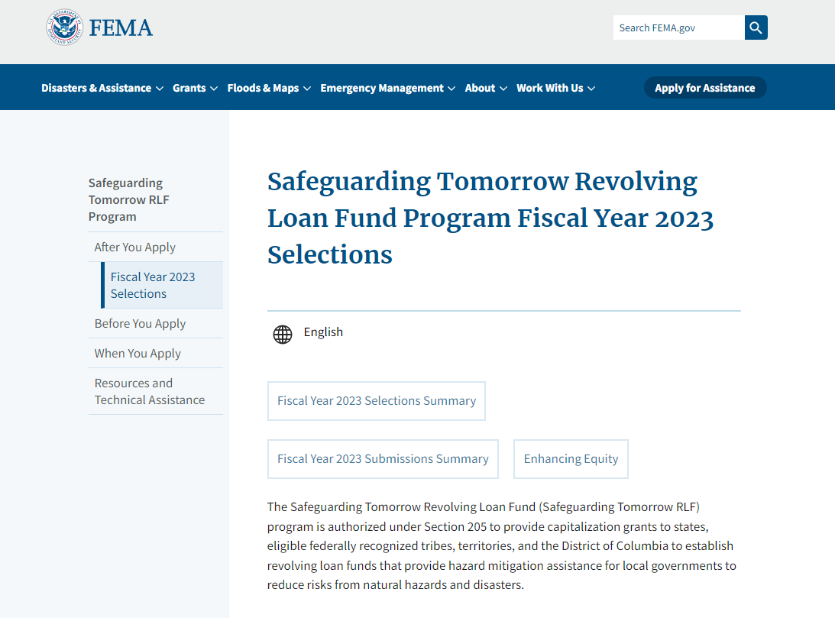
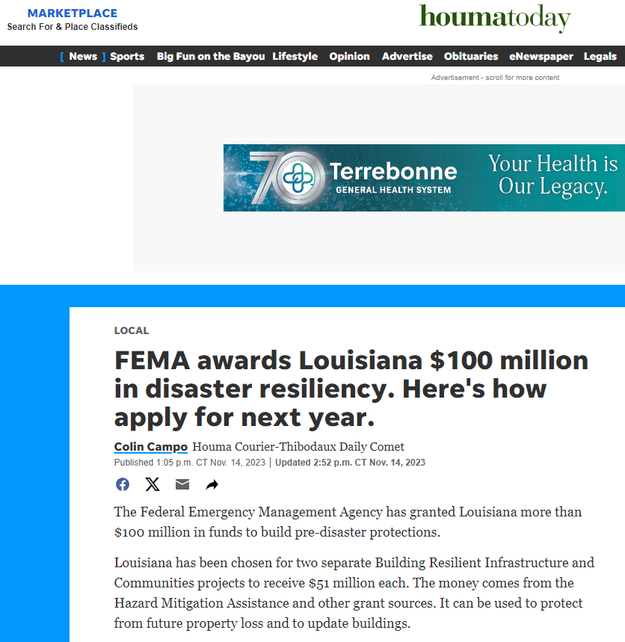
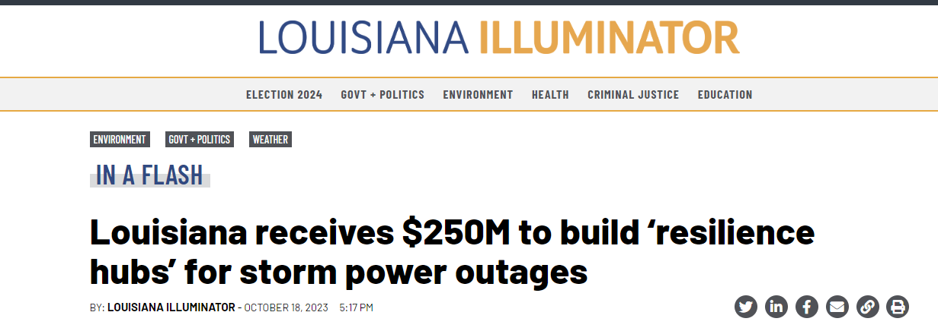
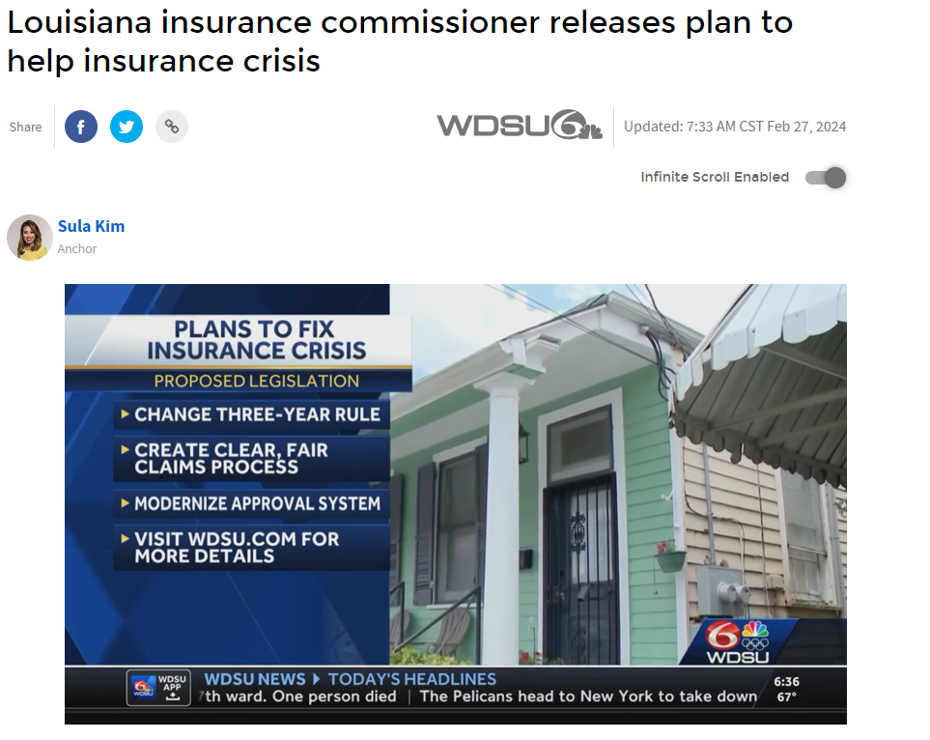

How Can We Bring Additional Resilience Funds to Louisiana?

Slide 22
Louisiana’s Resilient Priorities
Community Disaster
Resilience Zones (CDRZ)
W
BOSSIER
W
CLAIBORNE
UNION
MOREHOUSE
WEST
EAST
E
MOREHOUSE
BOSSIER
E
CLAIBORNE
UNION
MOREHOUSE
WEST
EAST
B
B
CLAIBORNE
WEST
BOSSIER
S
UNION
CARROLL
S
CARROLL
T
T
CARROLL
E
E
LINCOLN
R
CADDO
R
LINCOLN
CADDO
LINCOLN
CADDO
OUACHITA
RICHLAND
OUACHITA
RICHLAND
MADISON
Louisiana has 6 parishes named as Community Disaster Resilience Zones by the Federal Emergency Management Agency (FEMA).
The designates zones that can receive priority federal funding for building resilience.
These areas have access to technical assistance from FEMA.
Beyond these areas, the CRO recognizes the need to both support our coastal area as well as communities that previously have not been include in resilience efforts. This can only be achieved through collaboration.
JACKSON
OUACHITA
RICHLAND
MADISON
BIENVILLE
JACKSON
MADISON
BIENVILLE
JACKSON
BIENVILLE
RED
FRANKLIN
RED
NATCHITOCHES
CALDWELL
TENSAS
Parishes containing Community Disaster Resilience Zone (CDRZ) areas
N
CALDWELL
FRANKLIN
TENSAS
DESOTO
RED
CALDWELL
FRANKLIN
TENSAS
DESOTO
RIVER
DESOTO
RIVER
A
RIVER
T
WINN
C
WINN
H
WINN
CATAHOULA
I
CATAHOULA
T
CATAHOULA
C
O
LASALLE
C
LASALLE
O
SABINE
C
GRANT
LASALLE
O
SABINE
GRANT
N
H
GRANT
N
C
SABINE
E
C
O
S
O
R
R
D
D
I
I
A
RAPIDES
A
VERNON
RAPIDES
VERNON
RAPIDES
AVOYELLES
VERNON
AVOYELLES
AVOYELLES
WEST
EAST
ST
T
WEST
EAST
A
WASHINGTON
FELICIANA
FELICIANA
HELENA
N
FELICIANA
FELICIANA
SAINT
G
WASHINGTON
ALLEN
EVANGELINE
HELENA
I
BEAUREGARD
EVANGELINE
I
BEAUREGARD
POINTE
P
SAINT
ST.
POINTE
A
ALLEN
POINTE
A
COUPEE
LANDRY
COUPEE
LANDRY
EAST
H
COUPEE
EAST
H
ST
BATON
WEST
EAST
SAINT
WEST
BATON
O
ROUGE
BATON
TAMMANY
WEST
TAMMANY
BATON
LIVINGSTON
BATON
ROUGE
A
ROUGE
ROUGE
BATON
ROUGE
LIVINGSTON
JEFFERSON
ACADIA
ST.
ROUGE
CALCASIEU
JEFFERSON
ACADIA
LAFAYETTE
MARTIN
DAVIS
CALCASIEU
DAVIS
IBERVILLE
ASCENSION
IBERVILLE
ASCENSION
IBERVILLE
ASCENSION
ST.
ORLEANS
SAINT
ST.
JOHN
ORLEANS
ST.
JOHN
IBERIA
ASSUMPTION
JAMES
ST
J
ASSUMPTION
JAM ES
CHARLES
E
CAMERON
ASSUMPTION
CAMERON
VERMILION
ST.
F
F
P
ST BERNARD
L
P
SAINT BERNARD
MARTIN
L
E
L
A
L
ST.
A
R
F
A
MARY
F
S
O
Q
O
O
U
U
N
IBERIA
U
E
VER
R
TERREBONNE
R
C
M
C
H
I
TERREBONNE
H
E
N
E
E
S

Slide 23

Upcoming Funding Opportunities
STORM Program
Available Funding: $150M in Grants
Applications Due:
April 5th, 2024
Safeguarding Tomorrow Revolving Loan Fund Program
GOHSEP invites Louisiana’s local governments to submit mitigation project proposals for the Safeguarding Tomorrow through Ongoing Risk Mitigation (STORM) Revolving Loan Fund (RLF) Program. Project proposals are due to GOHSEP by April 5, 2024.
While FEMA is still passing down the funds from last year, the new funding round is open with a larger poll of funding.
NEWS (la.gov)
Past LA Performance:
GOHSEP received $6.9M in 2023 from a $50M award pool
LA’s Award:
Largest STORM award in the nation
To build on the success of receiving the largest award in the nation last year, we encourage eligible applicants to submit their proposed projects.
Resilience History in LA
Defining Resilience
2024 Plans
Supporting Resilience
Resilient Priorities

Slide 24
Upcoming Funding Opportunities
PROTECT
NCRF Program
BRIC & FMA
Promoting Resilient Operations for Transformative, Efficient, and Cost-saving Transportation Program
Building Resilient Infrastructure and Communities Program
Building Resilient Infrastructure and Communities Program
Flood Mitigation Assistance Program
$140M available in funding this year.
Pre-proposals due 4/10/2024
Final proposals due 7/2/2024.
State entities have received over $18M in the last two years.
Offers $3.01B in formula funding over the next two years. LA has received $79.1M in formula funds from 2022-2024.
Awaiting application date.
Eligible Entities:
  States
  Local and Tribal governments
  Planning organizations
Applications closed 2/29/2024
For the upcoming FY, the State hopes to increase applications and awarded projects.
Eligible Entities:
  State governments apply directly to FEMA
  Local governments apply through the State

Slide 25
Upcoming Funding Opportunities
GRIP – Smart Grid
GRIP – Grid Resilience
GRIP – GRID Innovation
Grid Resilience and Innovation Partnerships (GRIP) Program
Grid Resilience and Innovation Partnerships Program - Resilience Utility and Industry Grants
Grid Resilience and Innovation Partnerships Program – Grid Innovation
$1.08B is available in the grant cycle ending 4/17.
LA did not receive funding last year.
Concept Papers Due: 1/12/2024
Application Deadline: 4/17/2024
Eligible Entities:
  Higher education institutions
  For profit and non-profit entities
  State governments
  Local governments
  Tribal governments
$918M to is available in the grant cycle ending 4/17.
Entergy New Orleans received $54.8M from the prior award cycle.
Concept Papers Due: 1/12/2024
Application Deadline: 4/17/2024
Eligible Entities:
  Electric grid operator
  Electric storage operator
  Electricity generator
  Transmission owner/operator
  Distribution provider
  Fuel supplier
$1.82B available in the cycle ending 4/17.
LDENR received $249M for the HERO Project last year.
Concept Papers Due: 1/12/2024
Application Deadline: 4/17/2024
Eligible Entities:
  States
  Tribes
  Local governments
  Public utility commission

Slide 26
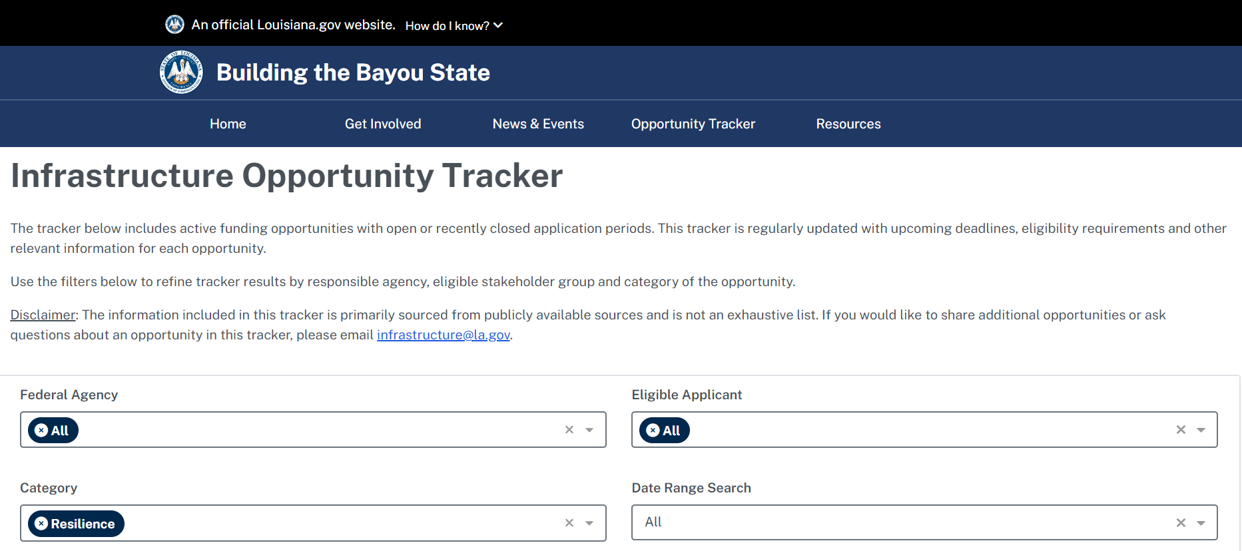

Upcoming Funding Opportunities
Visit the Opportunity Tracker tab on infrastructure.la.gov and select the resilience category to see current listing of resilience grants.

Slide 27
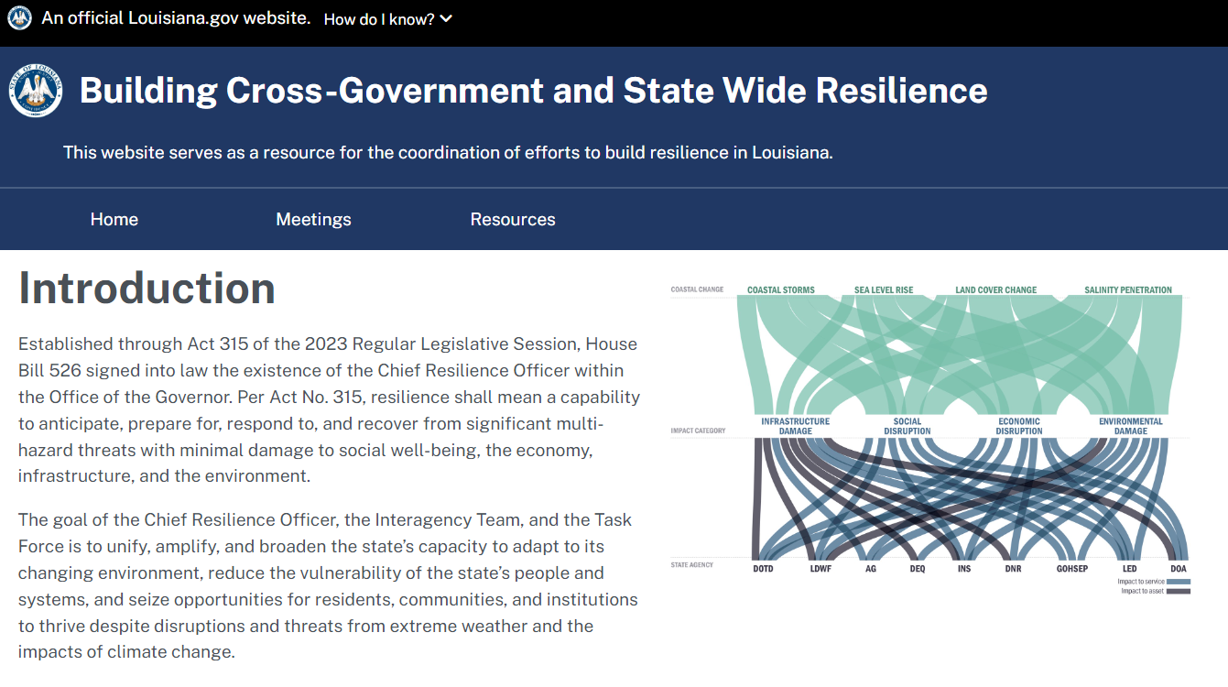

Check Back for Updates on Resilience.la.gov
Scan
The Resources tab will be updated with future meetings and past meeting notes.

Slide 28
Updates & Announcements

Slide 29
What resilience-related grants is your agency hoping to pursue this year and how can the CRO best support your efforts?
How can the CRO best support the incorporation of resilience in agency plans?

Slide 30

Adjourn: I Look Forward to Serving You
Stephen Swiber
Chief Resilience Officer
Stephen.Swiber@LA.GOV

